Slide 1


Predicting Heart Disease: A Data-Driven Approach
Heart disease is the leading cause of death worldwide (WHO, 2021).
We explore Python-based predictive modeling for early detection.
TEAM MEMBERS :
KUMAR KASHYAP (202410116100106)
KUNAL SINGH (202410116100109)
GAURAV VISHWAKARMA (202410116100076)
LAVISH NEHRA (202410116100111)
FACULTY :
MR APOORV JAIN
ASSISTANT PROFESSOR

Slide 2
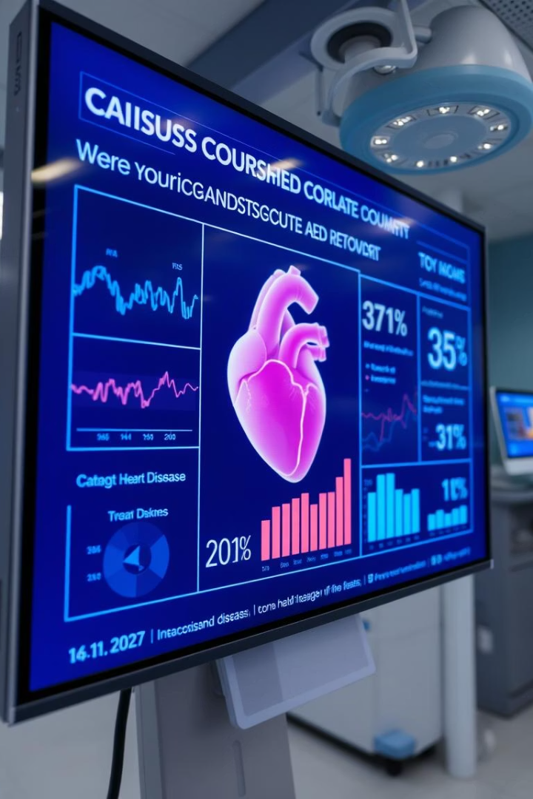
Introduction: The Power of Prediction
Impact of Heart Disease
Predictive Modeling
Identifies individuals at risk before symptoms appear.
Costs billions annually, affecting millions globally.
Early Intervention
Improves outcomes and lowers healthcare expenses.

Slide 3
Problem Statement & Objectives
Problem
Objectives
Late diagnosis causes severe complications and mortality.
Predictive Model: Achieve over 85% accuracy.
Risk Factor Analysis: Target modifiable behaviors like smoking and diet.

Slide 4

Python Powerhouse: Libraries for Success
Pandas
Tenserflow/Keras
Used to load, manipulate, and analyze structured date in tabular form (like CSV files).
Used to build and train machine learning and deep learning models.
Matplotlib & Seaborn
A plotting library used to create charts and graphs for data visualization.

Slide 5
Methodology: From Data to Prediction
Data Collection
Integrate from CDC, hospitals, and clinics.
Data Preprocessing
Impute missing values for accuracy.
Feature Selection
Identify top 10 predictors.
Model Training
Split data 80/20 for training and testing.
Evaluation
Use accuracy, precision, recall, and F1-score metrics.

Slide 6
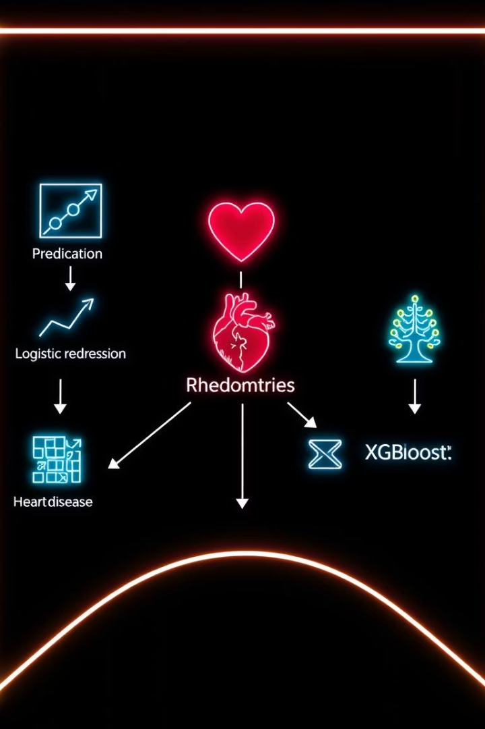
Algorithms in Action: Choosing the Right Fit
1
Artificial Neural Network (ANN)
A machine learning model inspired by human brain that learns patterns from data and makes predictions or decisions.
2
Random Forest Classifier
A machine learning algorithm that combines many decision trees to make accurate and stable predictions.

Slide 7
Output: Actionable Insights & Visualizations
Risk Score Dashboard
Visualizations
Sample Prediction
Color-coded risks: Green, Yellow, Red for easy assessment.
Displays impact of cholesterol and blood pressure.
65-year-old smoker with high BMI has 75% risk.

Slide 8

Conclusion: Transforming Healthcare with Data
Proactive Management
Empowered Patients
Early prediction allows targeted interventions.
Python models enable early and personalized care.
Future Integration
Wearables for continuous real-time risk monitoring.

Slide 9
Thank You

